Slide 1
Secure Authentication using IAM in Cloud Object Storage on IBM Cloud
-By: SHUBHANSHI Sharma
Internship Platform : AllSoft Solutions / IBM SkillsBuild
Dated : 16/07/2025

Slide 2
Introduction to the Project
What is IAM? Identity and Access Management (IAM) helps manage who has access to which IBM Cloud resources.
Purpose of Simulation:
IBM Cloud offers secure and scalable Object Storage for enterprise workloads.
IAM (Identity and Access Management) enables fine-grained access control.
This project demonstrates how to assign and test access for different user roles using IAM.

Slide 3
Objective of the Project
Simulate Manage, Writer, Viewer roles in IBM Cloud.
Control and test access to Cloud Object Storage.
Ensure secure user behavior based on least-privilege principle.
Understand how access groups and service IDs can isolate permissions.

Slide 4
Tools and Services Used
Platform: IBM Cloud
Services:
IBM Cloud Object Storage (COS)
IAM (Identity and Access Management)
Access Groups and IAM Roles
Accounts: 3 User IDs (Shubhanshi, Vinay, Shubhi)
Browser Profiles: Chrome (different sessions)

Slide 5
Step 1 – Create a Cloud Object Storage (COS) Instance
Go to IBM Cloud Console → Catalog
Search Cloud Object Storage → Click Create
Choose a region, name your instance
Use Lite plan (free) or standard

Slide 6
Step 2 – Create Access Groups
Go to Manage → Access (IAM) → Access Groups
Click Create Access Group
Name: Group-Monitoring, Group-Schematics, Group-Resource
💡 Benefit: Manage multiple identities with one set of permissions

Slide 7
Step 3 – Assign IAM Roles to Each Group
Open each Access Group → Go to Access → Assign Access
Assign roles:
Service: Cloud Object Storage
Resource: Your instance
Role: Viewer / Writer / Manager
Optional: Also assign Viewer/Editor on the Resource Group

Slide 8
Step 4 – Invite Users
.
Go to IAM → Users → Invite
Enter email, choose the Access Group
Send invite → User logs in from invite email

Slide 9
Step 5 – Create a Bucket for Testing
Go to Resource List → COS Instance → Buckets
Click Create Bucket
Choose region and name (e.g., test-bucket-1)

Slide 10
Step 5 – Log In as Assigned User
Each user logs into IBM cloud
Use incognito/another chrome profile
Access: Resource List → COS → Your Instance → Buckets Tab

Slide 11
Step 6 – Test Permissions
Action | Viewer | Editor | Manager
View buckets | ✅ | ✅ | ✅
Upload files to bucket | ❌ | ✅ | ✅
Delete objects | ❌ | ✅ | ✅
Create/Delete buckets | ❌ | ❌ | ✅
View lifecycle/CORS settings | ❌ | ❌ | ✅
View access tab | ❌ | Partial | ✅

Slide 12
Step 7 – Use Service IDs
Create a Service ID from IAM → service ids
Add it to an access group (like users)
Generate an API key
Use CLI or SDK to test programmatic access

Slide 13
Writers Testing Screenshots

Slide 14
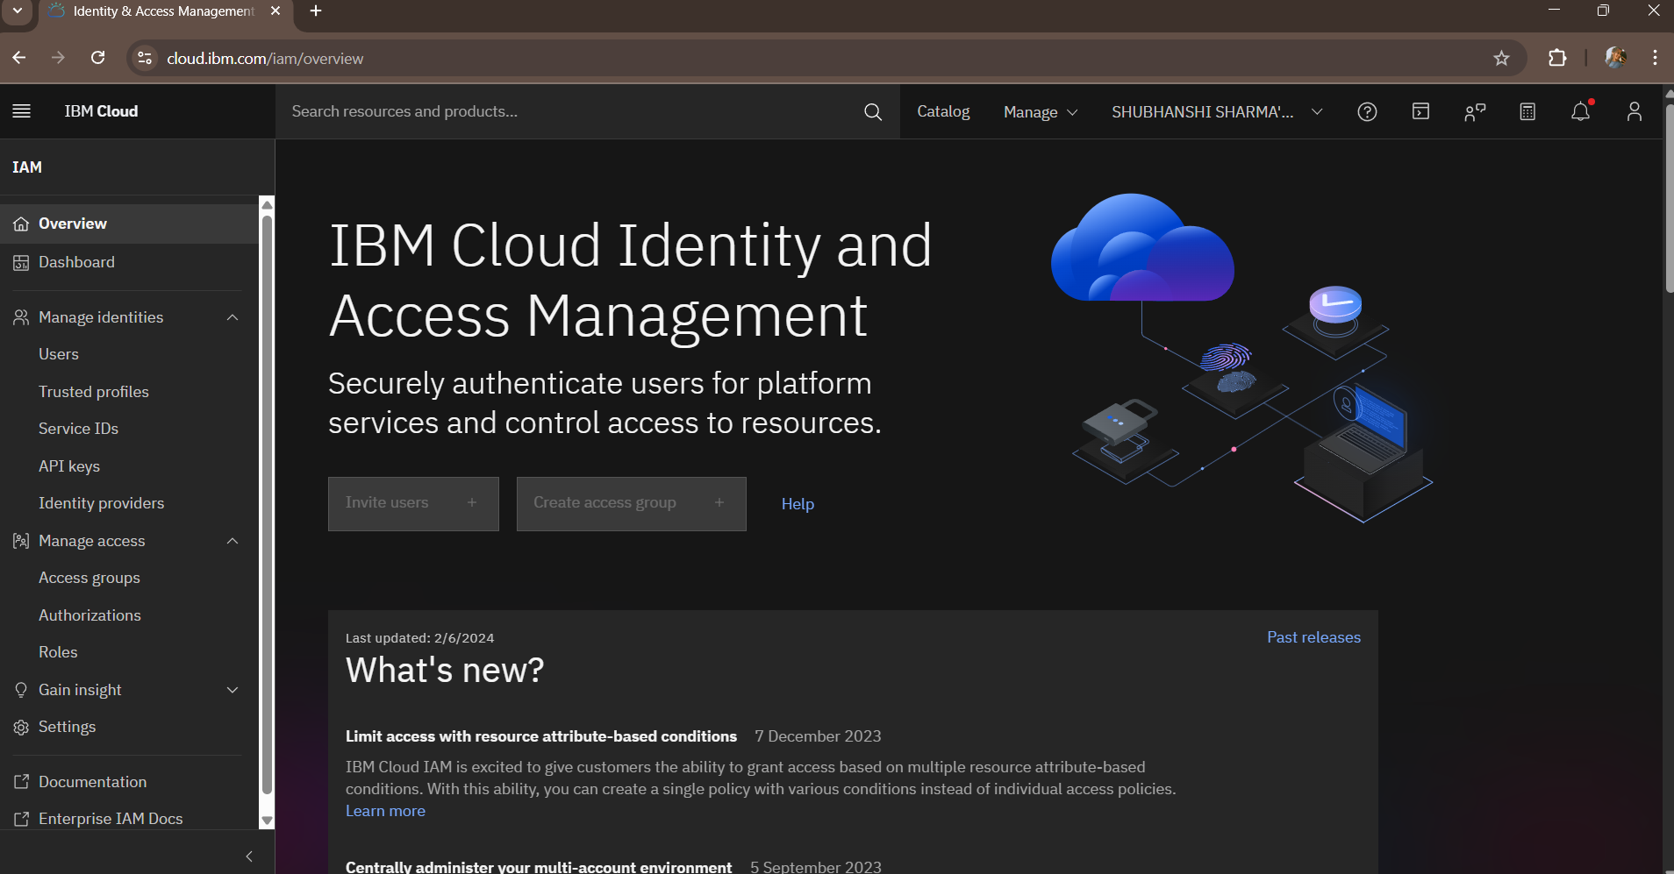

Slide 15
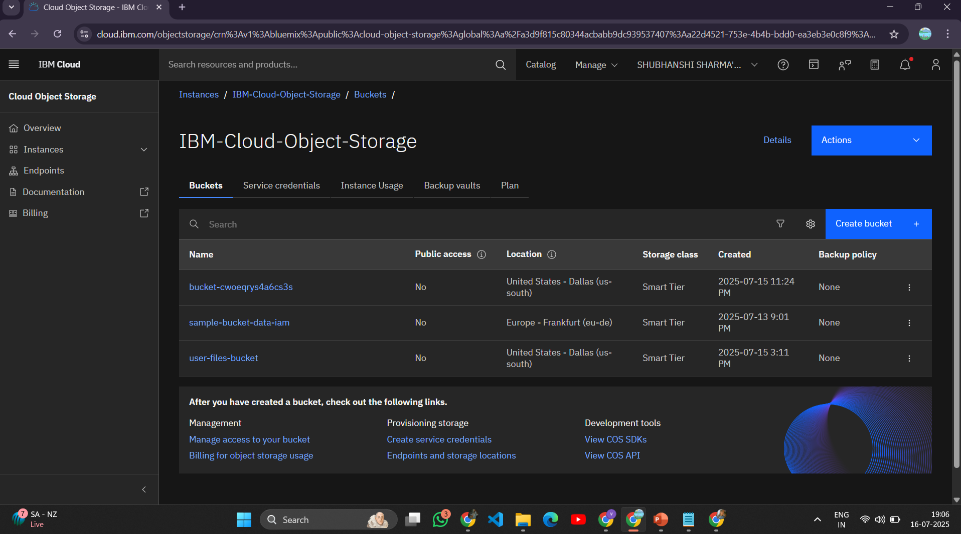

Slide 16
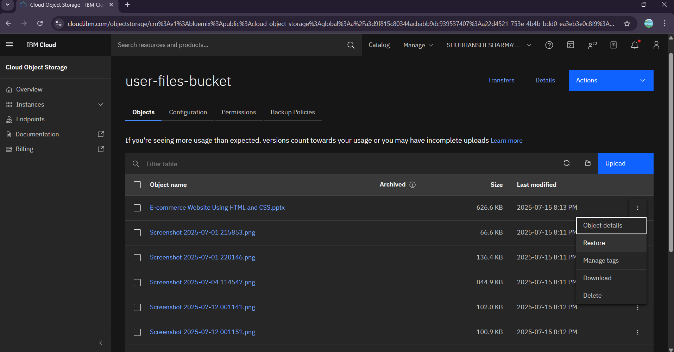

Slide 17
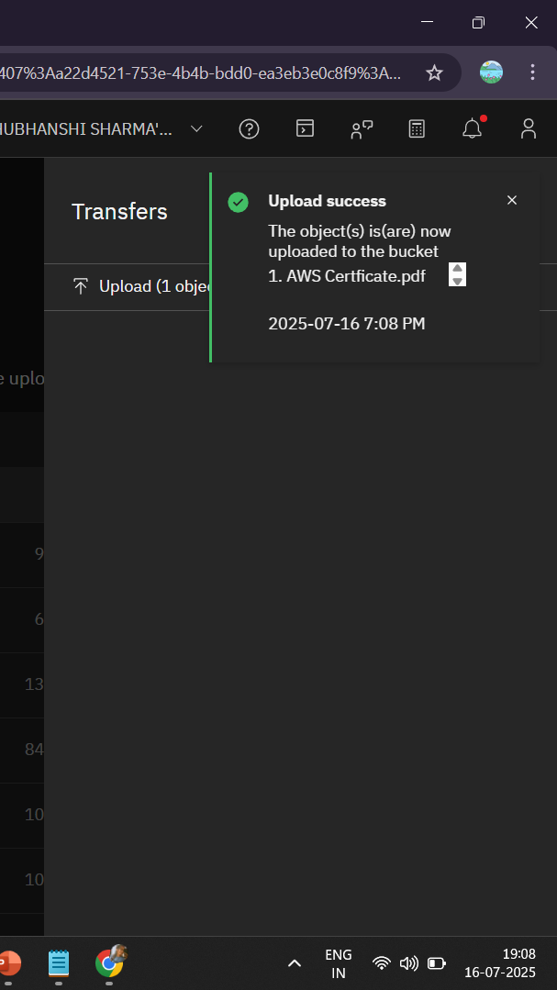
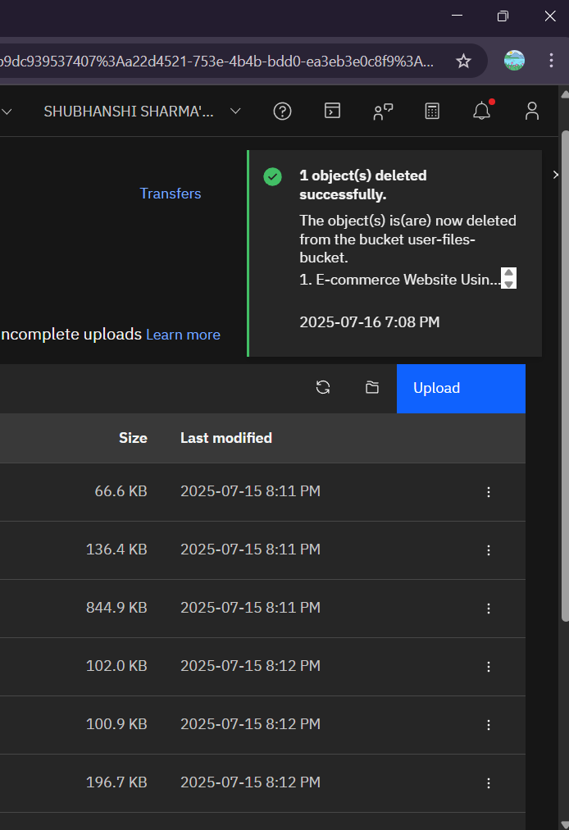

Slide 18
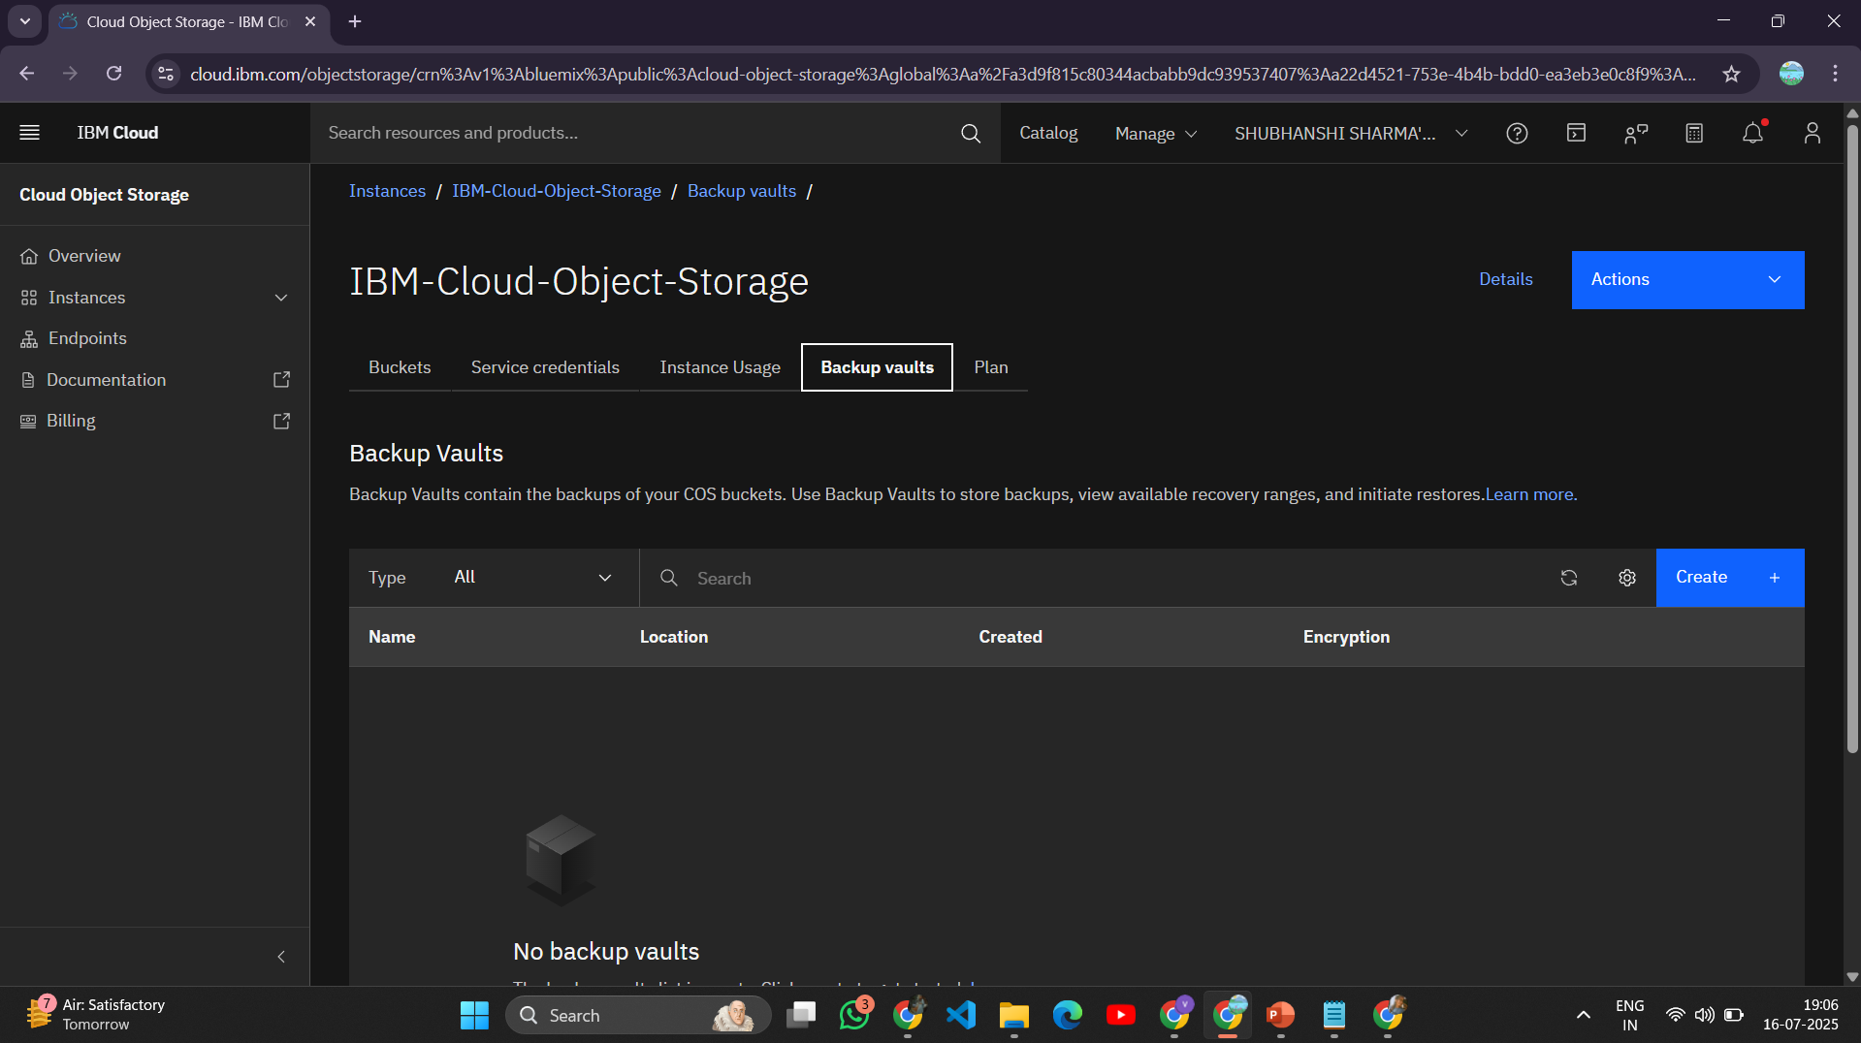

Slide 19
Viewers Testing Screenshots

Slide 20
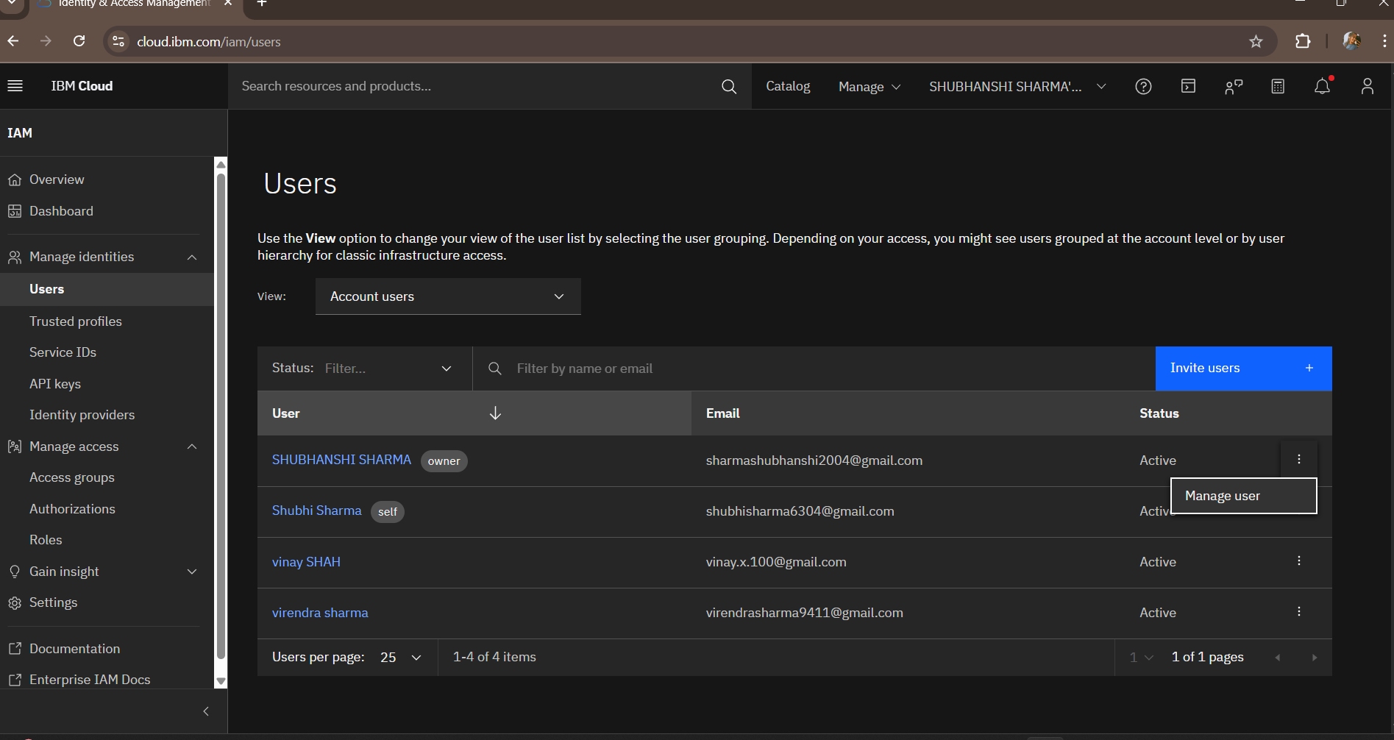

Slide 21
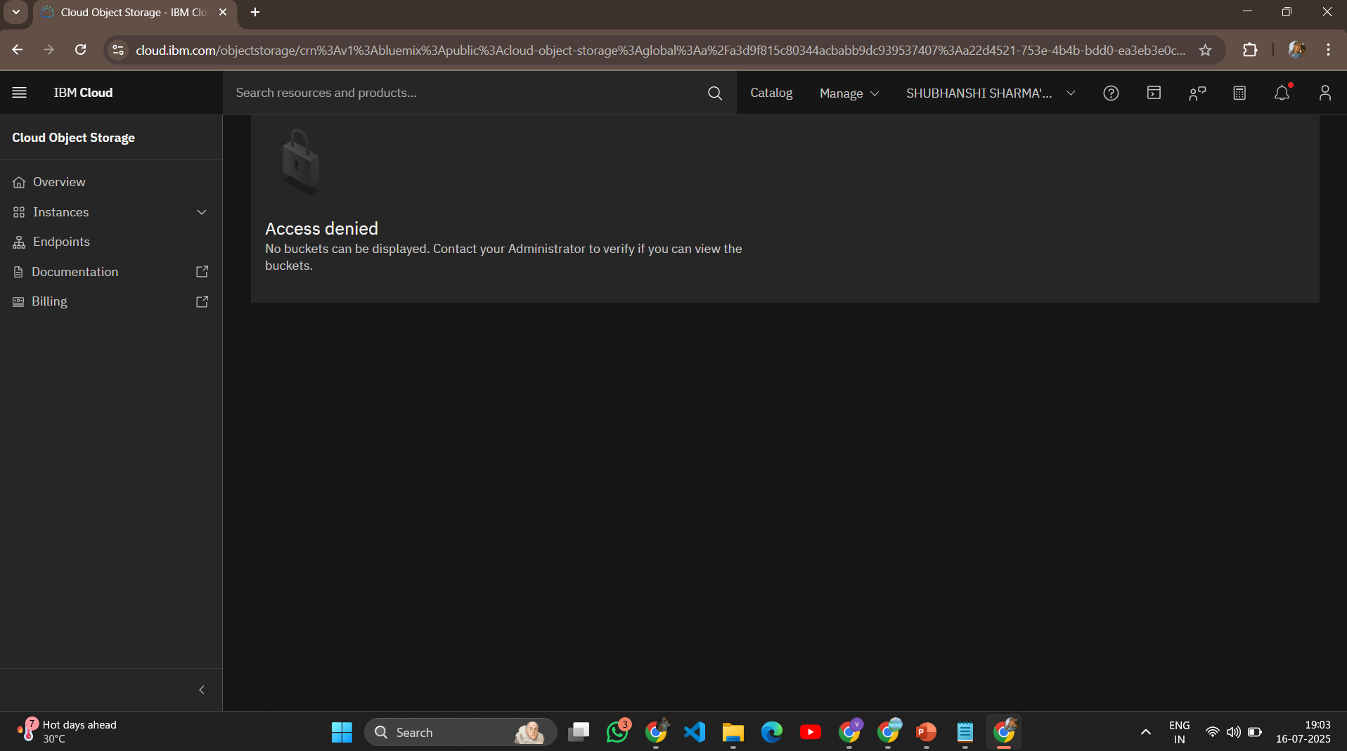

Slide 22
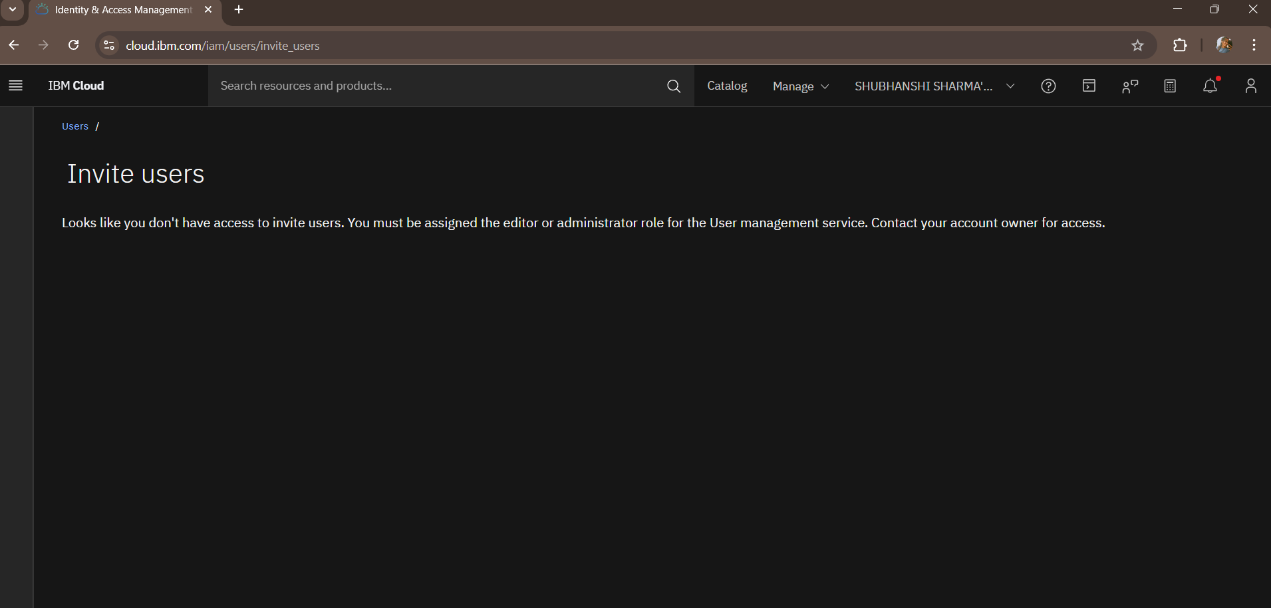

Slide 23
Service ID’s Testing Screenshots

Slide 24
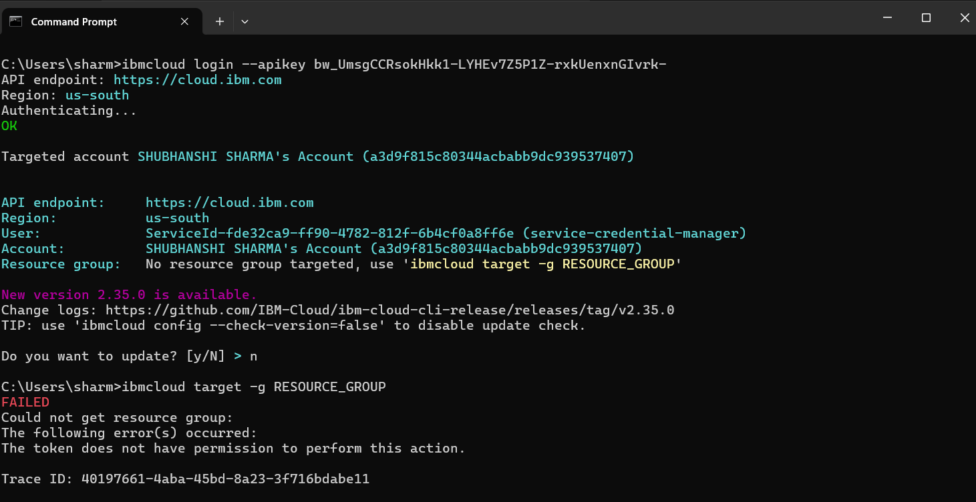

Slide 25
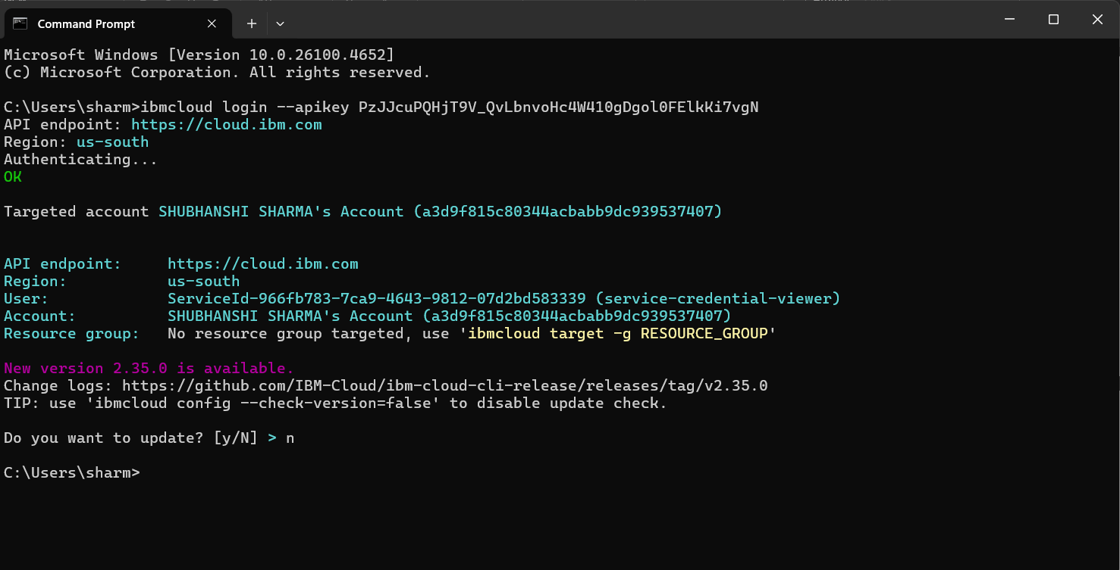

Slide 26
Summary of Workflow
Project Workflow Recap:
Owner creates cloud object storage instance
IAM roles are applied via access groups
Each user logs in separately and tests permissions
Restrictions work as expected depending on role
Shubhanshi (admin) has full access, Vinay can edit files only, Shubhi can view only

Slide 27
Output and Learning
Understood IBM IAM role-based access control
Learned how permissions cascade from resource group + service level
Simulated real company-like roles securely
Faced challenges with WatsonxAI COS instances and solved them

Slide 28
Conclusion & Future Scope
Conclusion:
IAM policies help manage cloud security effectively
Cloud Object Storage can be made highly secure by role-based access
Correct role-scope assignment is crucial
IAM simulation offers great hands-on experience for cloud projects
Future Scopes:
Implement automated Service IDs for external apps
Use API Key-based secure upload/download
Extend to Watson services with fine-grained IAM policies
Implement access monitoring and audit logging

Slide 29
Thank You!
AllSoft Solutions
IBM Cloud platform
Mentors / Instructors

